Slide 1
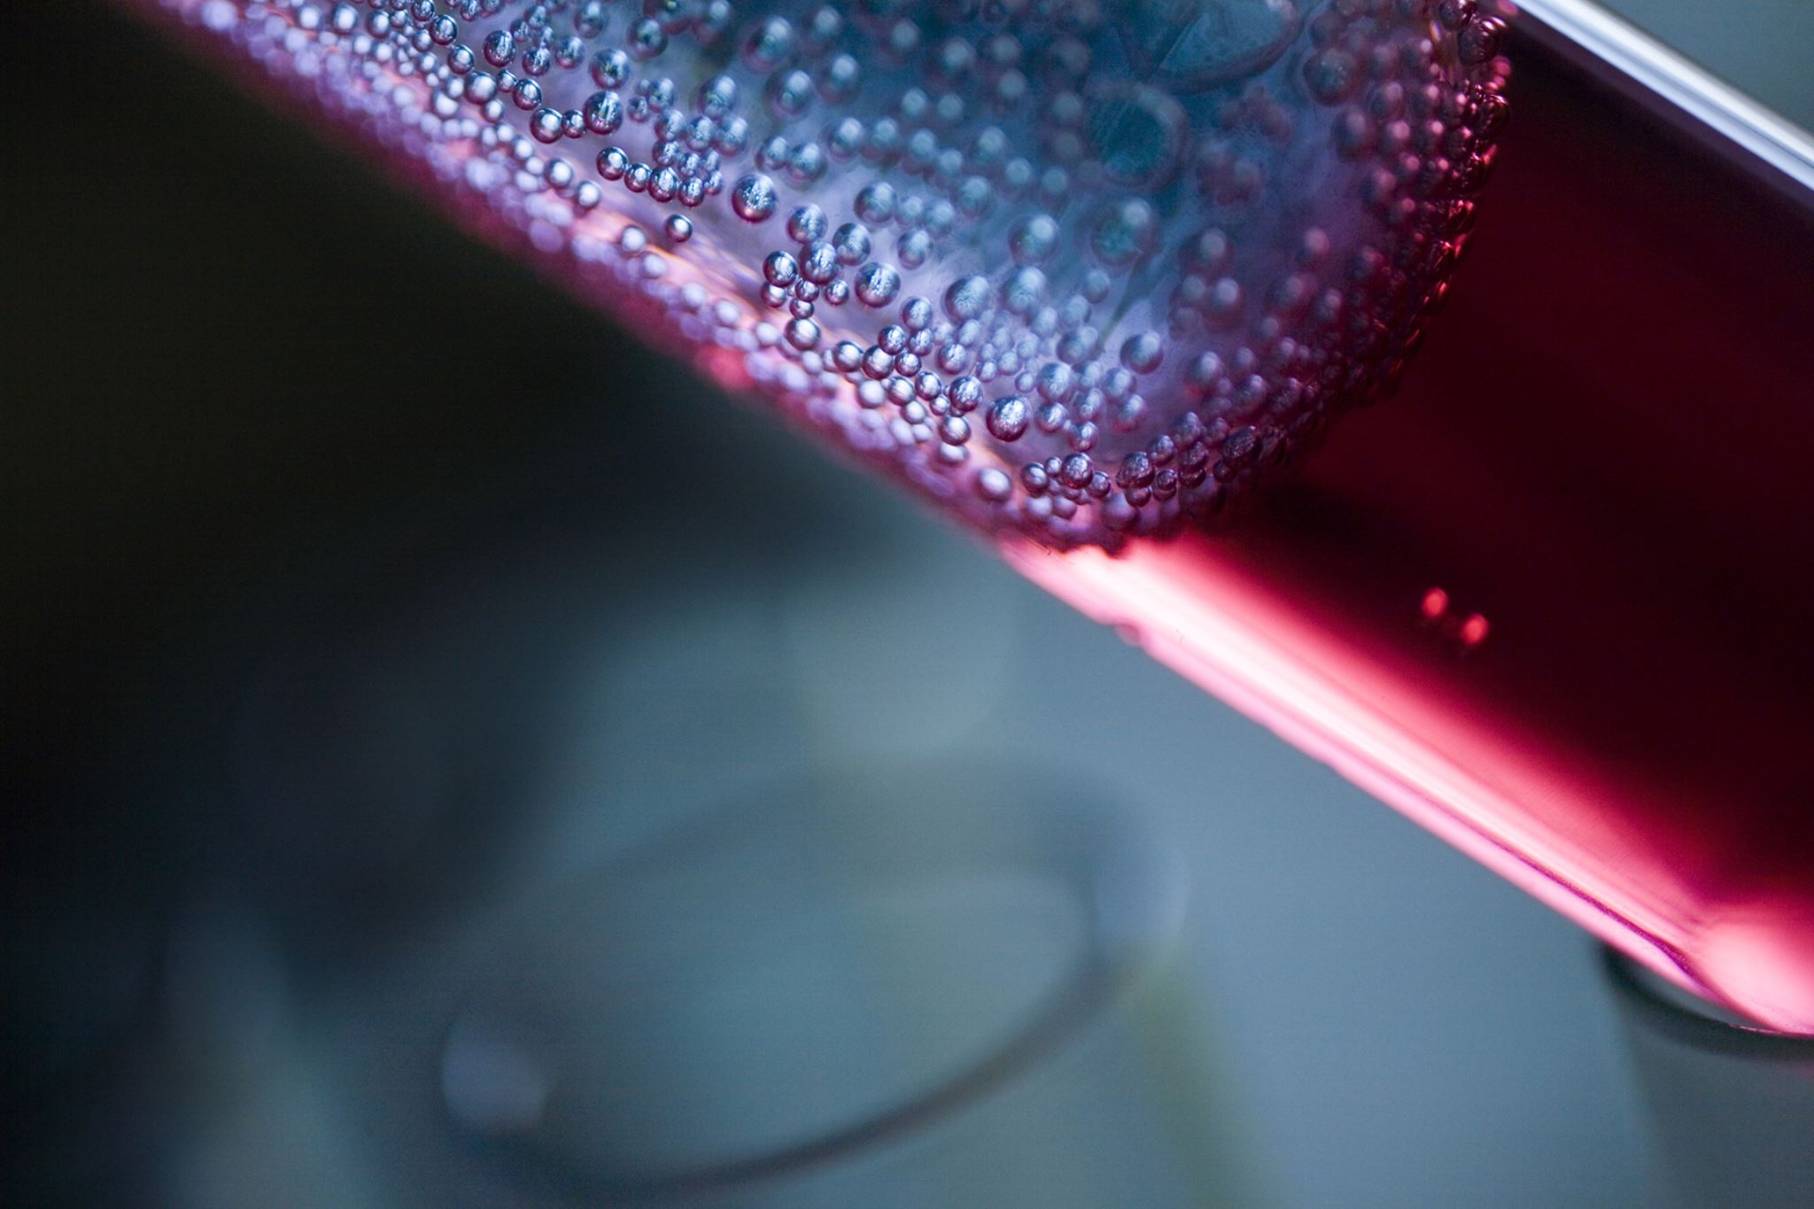
Wine Quality Prediction Using Supervised Learning
• Objective: Can We Predict Wine Quality Based on Its Chemical Properties?
• Classification: Low, Medium, High quality
• Dataset: Merged Red and White Wines
• Tools: Python, Spark SQL, Scikit-learn

Slide 2
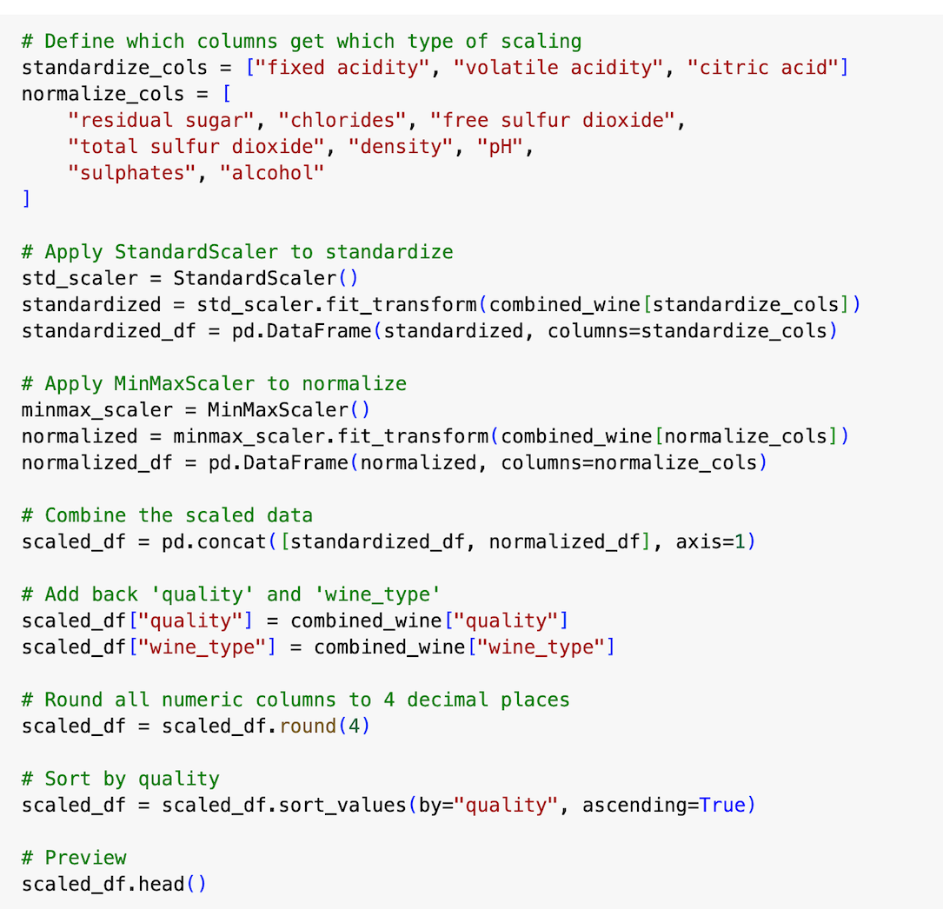
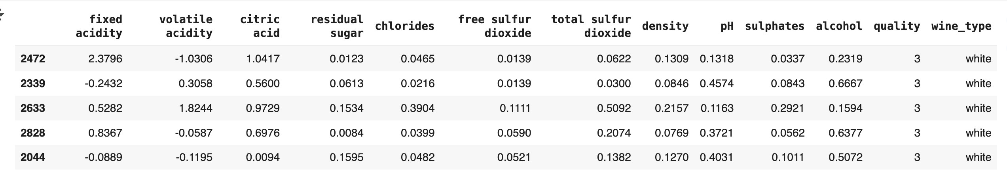
Data Cleaning & Feature Engineering
• Removed nulls, merged datasets
• Applied feature scaling
• Saved as cleaned_wine_data.csv

Slide 3
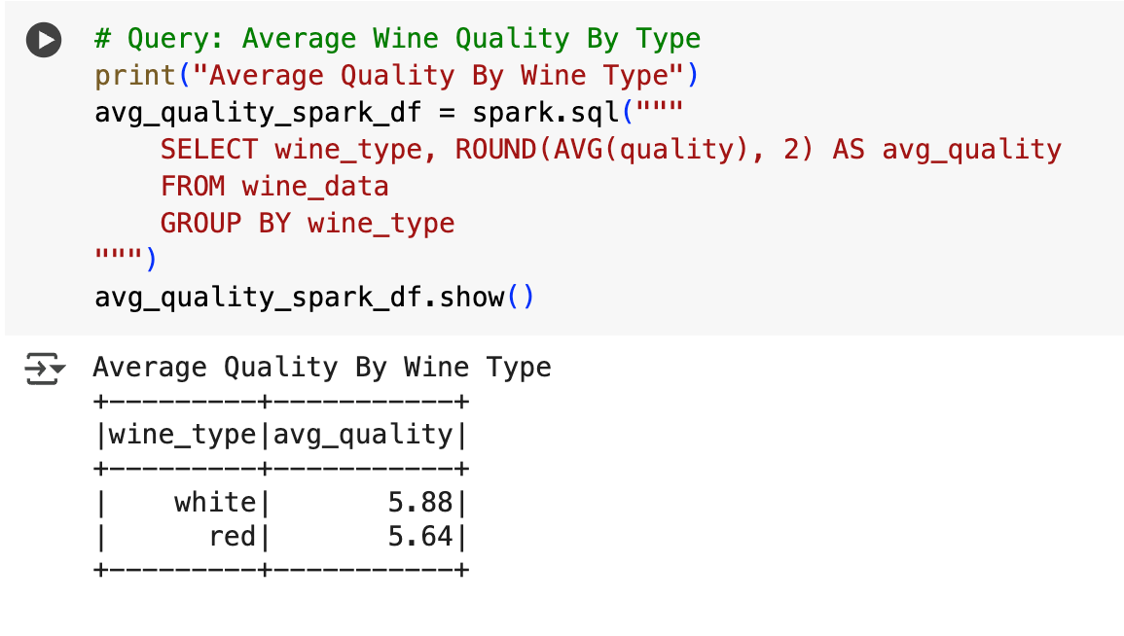
Spark SQL Analysis
• White wines scored slightly higher on average
• Alcohol is a strong indicator of quality
• Density negatively correlates with quality

Slide 4
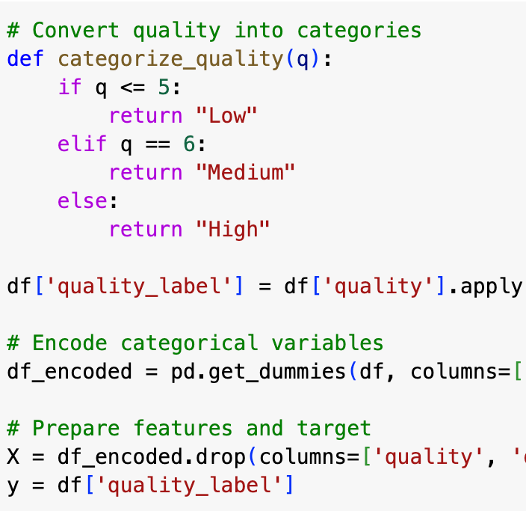
Model Preparation & Label Binning
• Class Encoding:
• 0 = Low (3–5)
• 1 = Medium (6)
• 2 = High (7+)

Slide 5
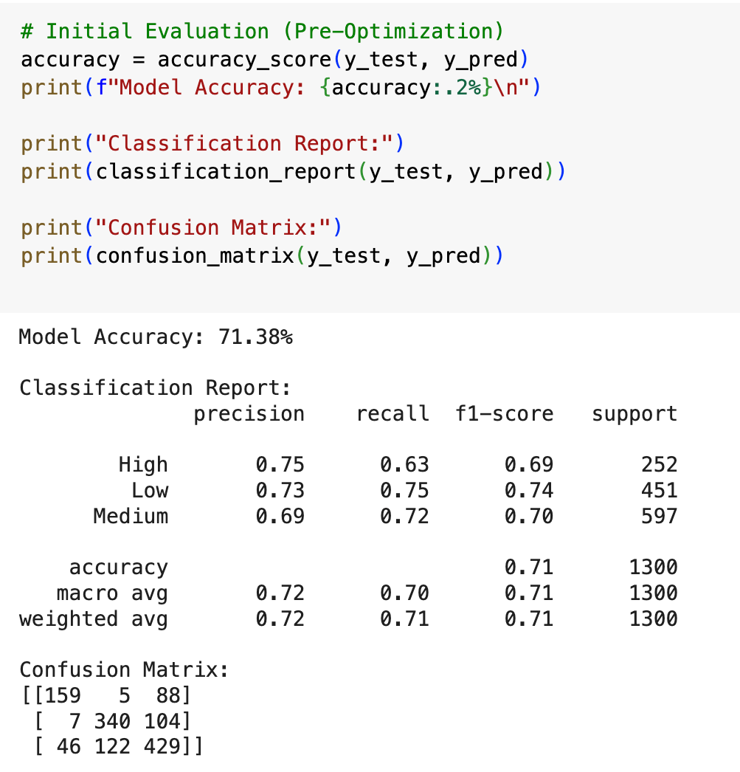
Initial Model Training
• Used Random Forest as baseline model
• Accuracy: 88.62%
• Evaluated using precision, recall, F1

Slide 6
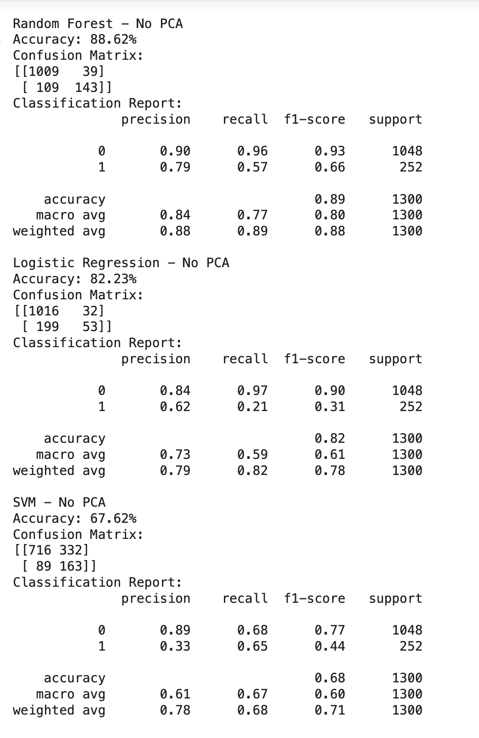
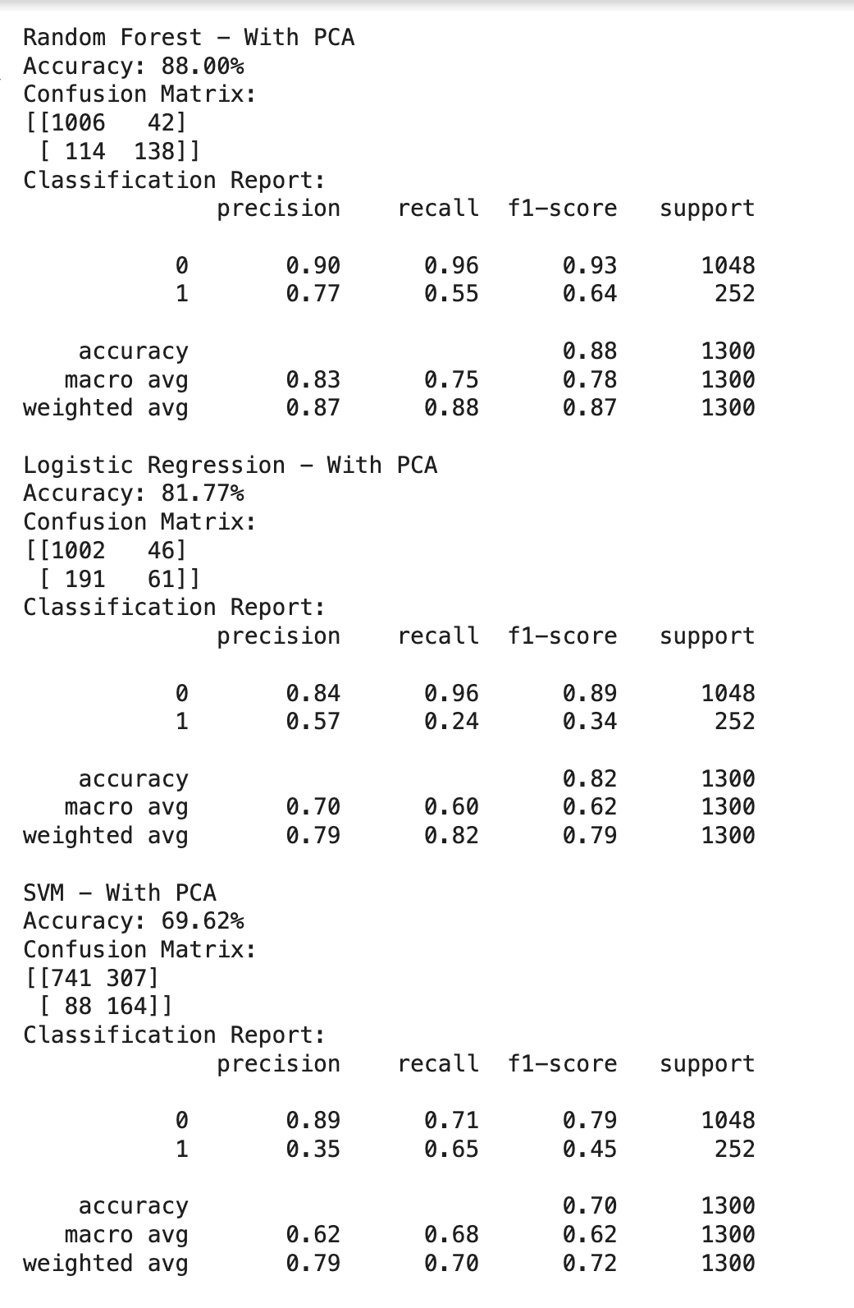
Model Optimization
• Tried Logistic Regression & SVM
• PCA used to reduce dimensions
• Random Forest performed best overall

Slide 7
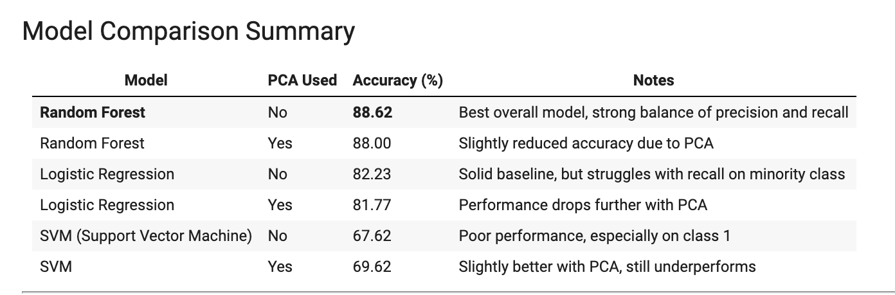
Model Evaluation
• High precision and recall for most classes
• Model generalizes well to unseen data
• Final accuracy: 88.62%

Slide 8

Next Steps: Visualizing in Tableau
• Coming up: Feature impact visualizations
• Correlation matrix, class predictions, and wine-type quality breakdown

